Slide 1

Smart healthcare adopting MQTT
Sara Walid Ahmed
Ahmed Mohamed Gaber
Hager Sayed Soliman
Abdelrahman Mohsen

Slide 2
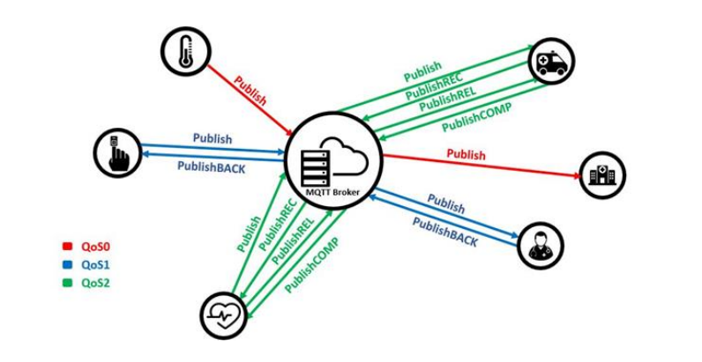
What is MQTT? message queue telemetry transport
Application layer protocol
MQTT server is called broker, it serves as the network's hub and is the only node through which data is exchanged. Clients can subscribe or publish topics through broker.
MQTT is a great option for IoT systems.High throughput, reduced latency,less bandwidth usage when compared to other protocols.
It’s very secure because it’s use Transport Layer Security (TLS) and Secure Sockets Layer (SSL)
Its one-to-many and many-to-many architecture which enables clients to subscribe to more than one topic at once
Quality of service levels: This protocol describes the Quality of Service (QoS) levels that are a deal within two nodes sending a message, assurance of distribution of data.
Qos0:message is sent at most once and it does not provide guarantee delivery of a message.
Qos1: the data is sent at least once and it is possible to deliver a message more than once.
Qos2: the message is sent exactly once by using 4-way handshaking.used if a system needs constant data delivery

Slide 3
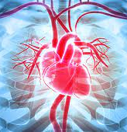
The problem
If the patient has heart disease and symptoms which not usually appears, it could be dangerous in some cases which may cause of death the patient.
monitor standard ways cannot record of symptoms during a few seconds. In this case, the doctor should recommend a portable device that monitors the blood oxygen level, heart rate and body temperature which usually takes 10-15 min.

Slide 4
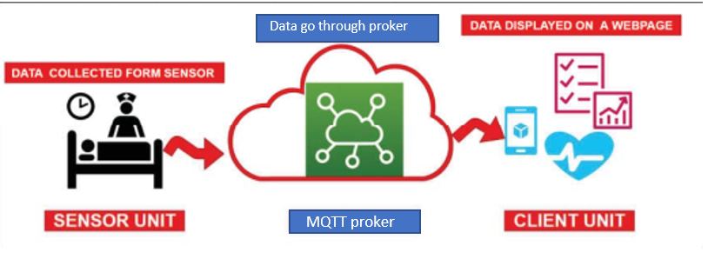
Proposed Solution
connecting a sensor to the patient's body then connect it to the microcontroller( ESP8266 - Esp32).
A patient can carry the device in his pocket, or which is attached to a shoulder strap
The device sends measuring results to the MQTT server(broker) using Wi-Fi.
patient, doctor, and anyone interested in the patient's condition can access the server over the phone or desktop and view the patient's measured data.
A solution proposed for patients who can’t read or write. We put medicines in a box and beside it there’s
A led when doctor wants patient to take specific drug, he will publish to the topic to turn on the led.

Slide 5
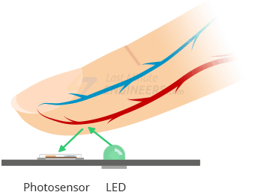
How does Heartrate Sensor Works
A pulse sensor, works by shining a green light of wave lenght (~ 550nm) on the finger and measuring the amount of reflected light with a photosensor.
oxygenated hemoglobin in arterial blood has the property of absorbing green light(the higher the hemoglobin, the greater the absorption of green light).
With each heartbeat, blood is pumped through the finger, causing a change in the amount of reflected light, which in turn produces a waveform at the photosensor’s output.
The noisy signal, is passed through an R/C filter and then amplified with an Op-Amp to create a signal that is significantly large.
The measure between the peaks, is the heartrate.

Slide 6
Implementation Details
ESP8266 act as the control unit is used to send the data measured by the sensors to the MQTT server and receive commands from the doctor.
The sensor used are temperature sensor LM35, heart rate (pulse) sensor
ESP8266 is collecting the data from the sensor, then send it to a free server called Mosquitto (broker) which is an open-source message broker that implements the MQTT protocol.
By using free google support tool called MQTTLens which supports MQTT communications, where we can use it to send and watch the data from computer.
To watch the data of nodes from mobile we used an application called MyMQTT a free android app which can publish or subscribe the topics.

Slide 7
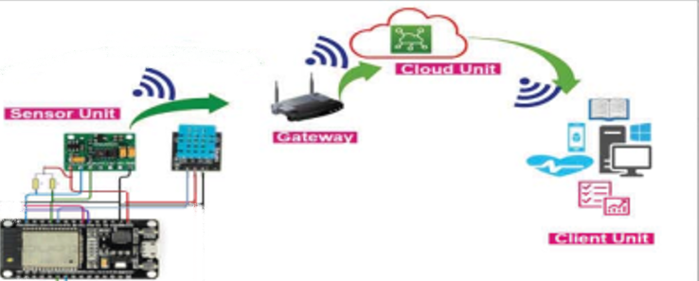
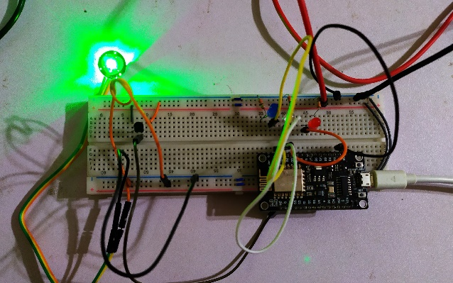

Slide 8
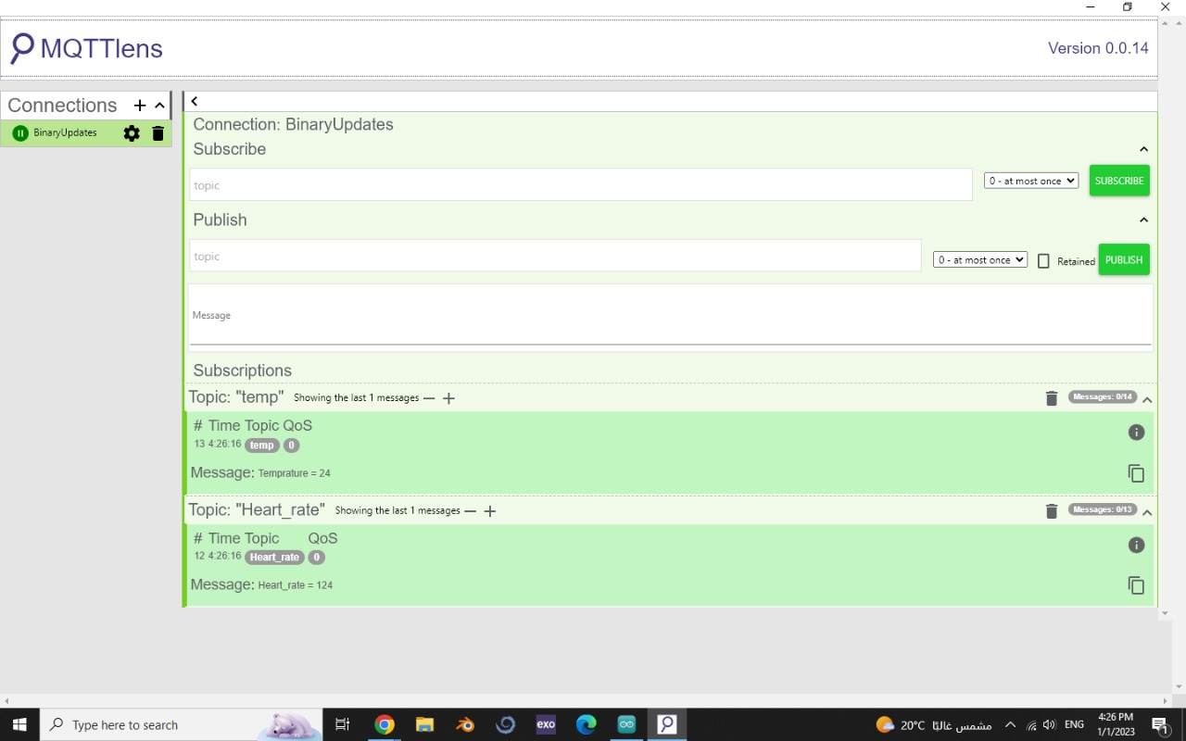
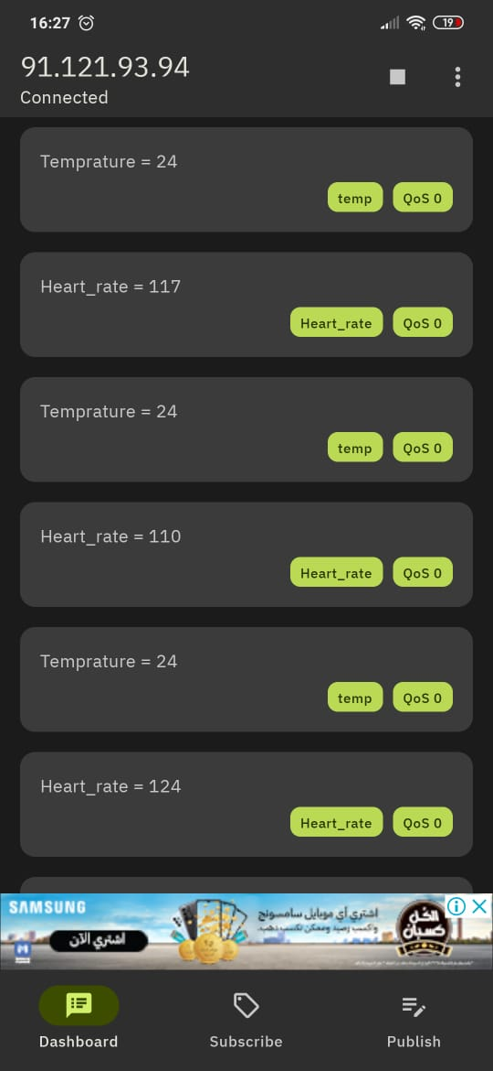
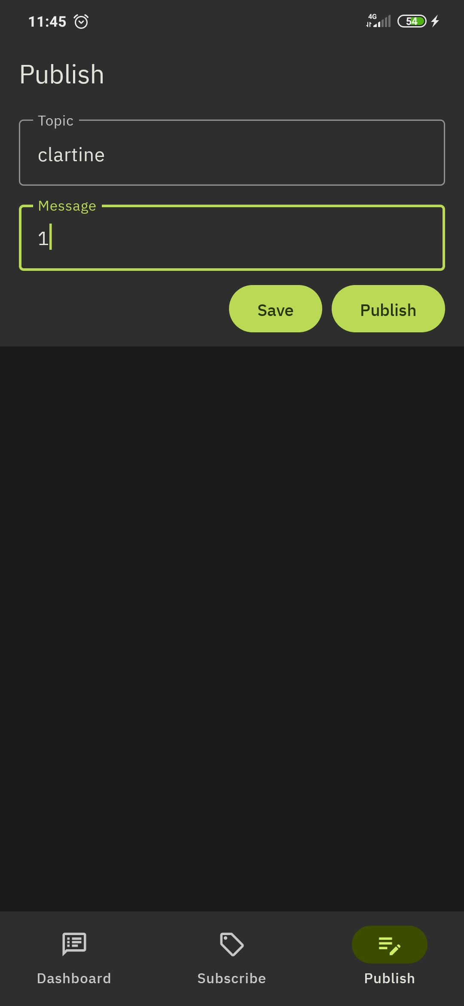
Results:
MyMQTT

Slide 9
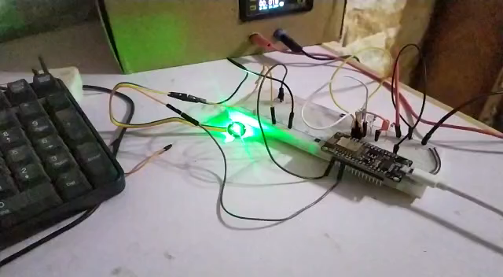
Video:

Slide 10
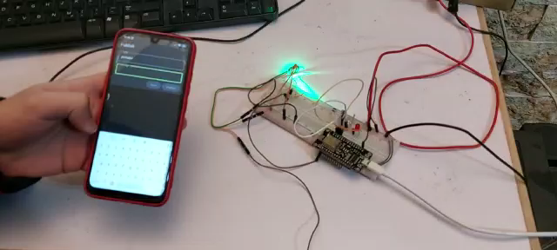
Video2

Slide 11
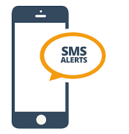
Future Work
Introduce software component to identify emergency vital signs that affect the patient's situation. These improvements will give proposed system ability to send urgent alarm in critical status through call, E-mail, or SMS notification.

Slide 12

Thank you

